Slide 1



Noida Institute of Engineering and Technology, Greater Noida
Knowledge Representation & Expert System
Unit: 04
Knowledge representation
Course Details
(B Tech 3rd Sem)
Alka Singh
Assistant Professor
B.Tech AIML
Alka Singh ACSAI-301 AI Unit 04

Slide 2
Hidden Markov Models
Hidden Markov Model is a partially observable model, where the agent partially observes the states.
This model is based on the statistical Markov model, where a system being modeled follows the Markov process with some hidden states.
In simple words, it is a Markov model where the agent has some hidden states. L.E. Baum and coworkers developed the model.
Alka Singh ACSAI-301 AI Unit 04

Slide 3
Markov Process
The HMM model follows the Markov Chain process or rule. This process describes a sequence of possible events where probability of every event depends on those states of previous events which had already occurred. Andrey Markov, a Russian mathematician, gave the Markov process. The Markov chain property is:
P(S_{ik}|S_{i1},S_{i2},…..,S_{ik-1}) = P(S_{ik}|S_{ik-1}), where S denotes the different states.
Alka Singh ACSAI-301 AI Unit 04

Slide 4
Markov Models
Markov model is a stochastic model which is used to model the randomly changing systems. The assumption is that the future states depend only on the current state, and not on those events which had already occurred. Such type of model follows one of the properties of Markov.
The process followed in the Markov model is described by the below steps:
Carries a set of states: {s₁, s₂,….s_{N}}
Sequence of states is generated as {s_{i1}, s_{i2},….,s_{ik},….}, when the process moves from one state to the other.
Follows the Markov Chain property (described above)
The probabilities which need to be specified to define the Markov model are the transition probabilities and the initial probabilities.
Transition Probability, a_{ij} = P(s_{i} | s_{j}), and Initial Probability, √_{i} = P(s_{i})
Alka Singh ACSAI-301 AI Unit 04

Slide 5
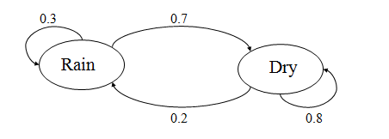
Example of Markov Models(MM)
Consider the given probabilities for the two given states: Rain and Dry.
Alka Singh ACSAI-301 AI Unit 04

Slide 6
The initial probabilities for Rain state and Dry state be:
P(Rain) = 0.4, P(Dry) = 0.6
The transition probabilities for both the Rain and Dry state can be described as:
P(Rain|Rain) = 0.3, P(Dry|Dry) = 0.8
P(Dry|Rain) = 0.7, P(Rain|Dry) = 0.2 .
Now, if we want to calculate the probability of a sequence of states, i.e., {Dry,Dry,Rain,Rain}.
It will be calculated as:
P({Dry, Dry, Rain, Rain}) = P(Rain|Rain) . P(Rain|Dry) . P(Dry|Dry) . P(Dry)
= 0.3 x 0.2 x 0.8 x 0.6
= 0.0288
Alka Singh ACSAI-301 AI Unit 04

Slide 7
Drawbacks of Hidden Markov Model
Evaluation Problem: A HMM is given, M= (A,B,√), and an observation sequence, O=o1 o2,….oK. Evaluate the probability that model M has generated the sequence O.
Decoding Problem: A HMM is given, M= (A,B,√), and the observation sequence, O=o1 o2,….oK. Calculate the most likely sequence of hidden states Si which produced this observation sequence O.
Learning Problem: Given some general structure of HMM and some training observation sequences O=01 o2,….oK. Calculate HMM parameters, M= (A,B,√) which best fits the training data.
Note: Observation O= o1 o2,….oK denotes a sequence of observations oK {v1,……,vM}
Alka Singh ACSAI-301 AI Unit 04

Slide 8

Bayesian Belief Network in artificial intelligence
Bayesian belief network is key computer technology for dealing with probabilistic events and to solve a problem which has uncertainty. We can define a Bayesian network as:
"A Bayesian network is a probabilistic graphical model which represents a set of variables and their conditional dependencies using a directed acyclic graph.“
It is also called a Bayes network, belief network, decision network, or Bayesian model.
Alka Singh ACSAI-301 AI Unit 04

Slide 9
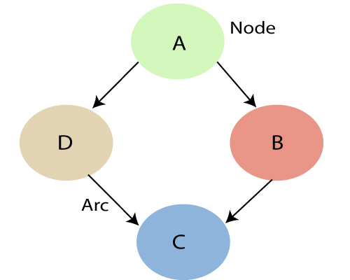
Bayesian Belief Network in artificial intelligence
A Bayesian network graph is made up of nodes and Arcs (directed links), where:
Alka Singh ACSAI-301 AI Unit 04

Slide 10
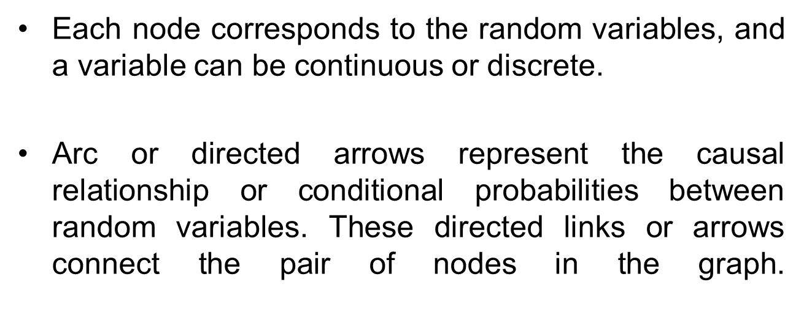
Bayesian Belief Network in artificial intelligence
Alka Singh ACSAI-301 AI Unit 04

Slide 11
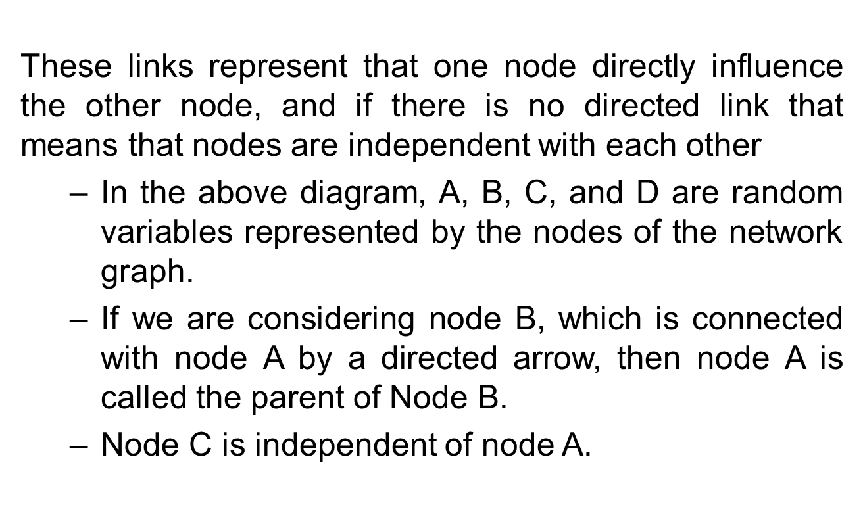
Bayesian Belief Network in artificial intelligence
Alka Singh ACSAI-301 AI Unit 04

Slide 12
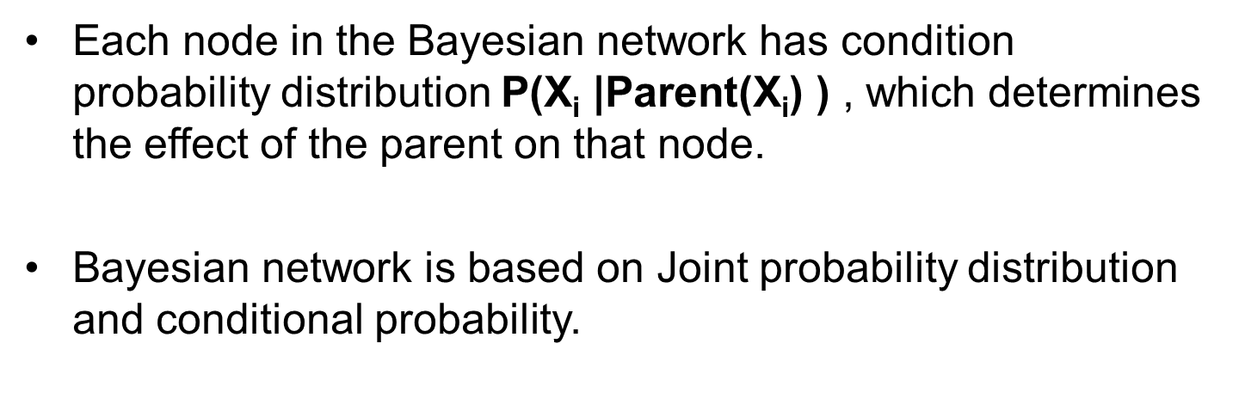
Bayesian Belief Network in artificial intelligence
Alka Singh ACSAI-301 AI Unit 04

Slide 13
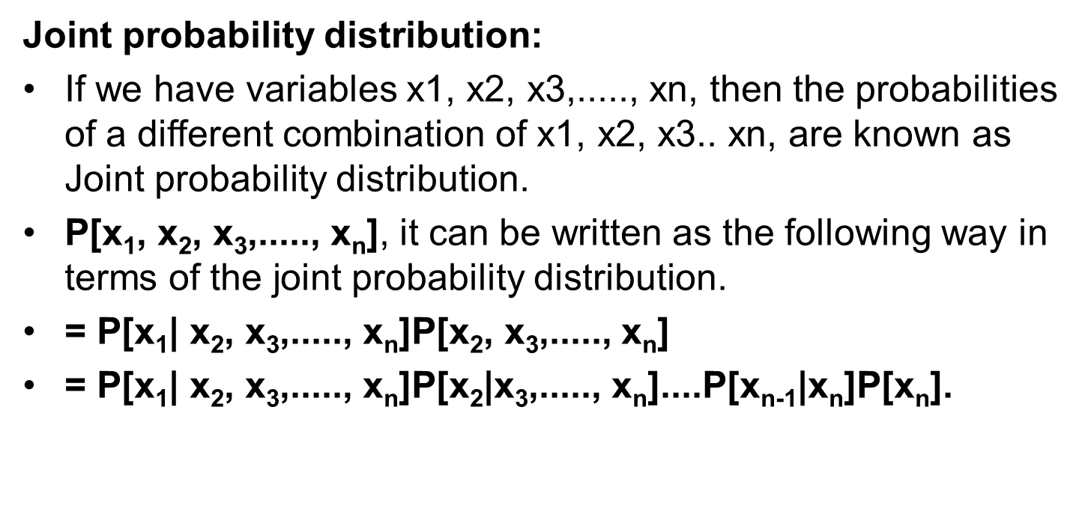
Bayesian Belief Network in artificial intelligence
Alka Singh ACSAI-301 AI Unit 04

Slide 14
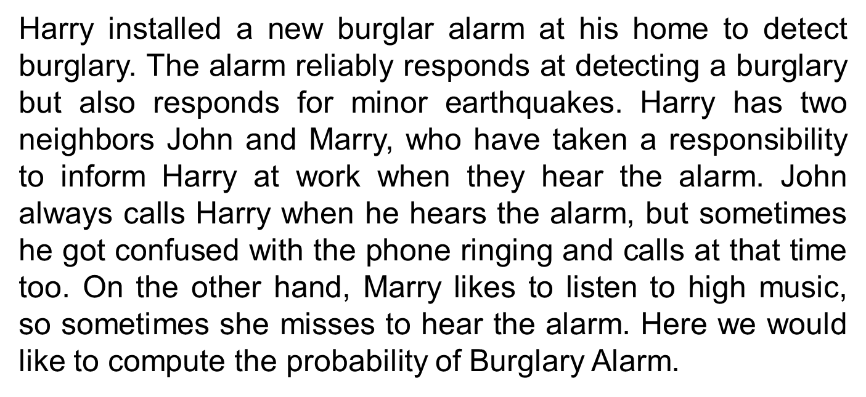
Bayesian Belief Network Example

Slide 15
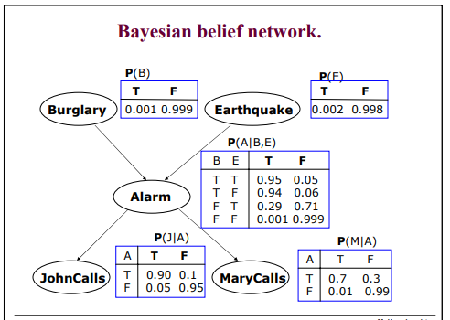
Bayesian Belief Network Example

Slide 16
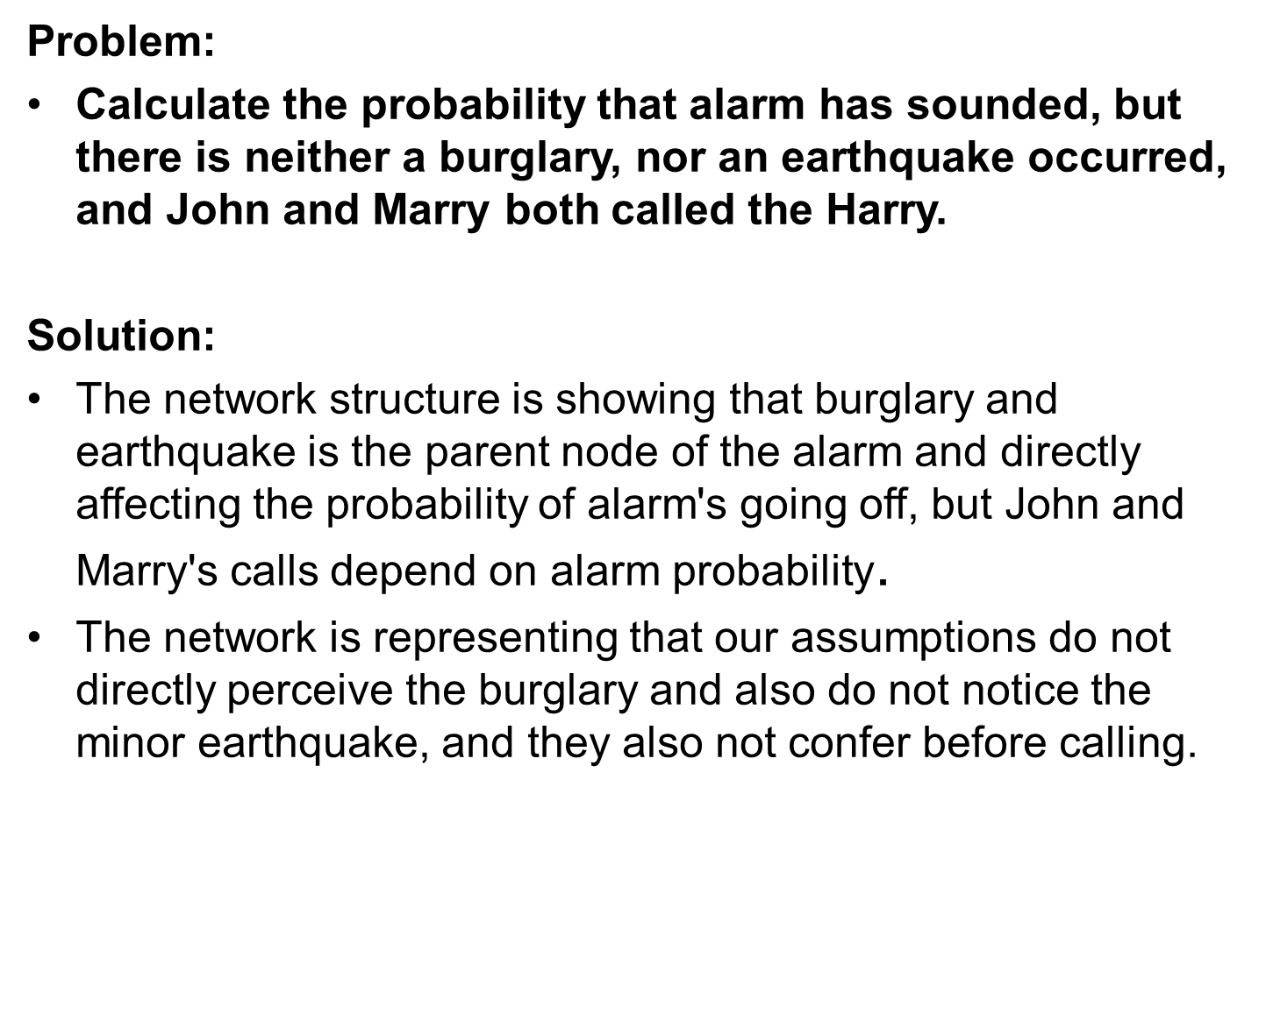
Bayesian Belief Network Example

Slide 17
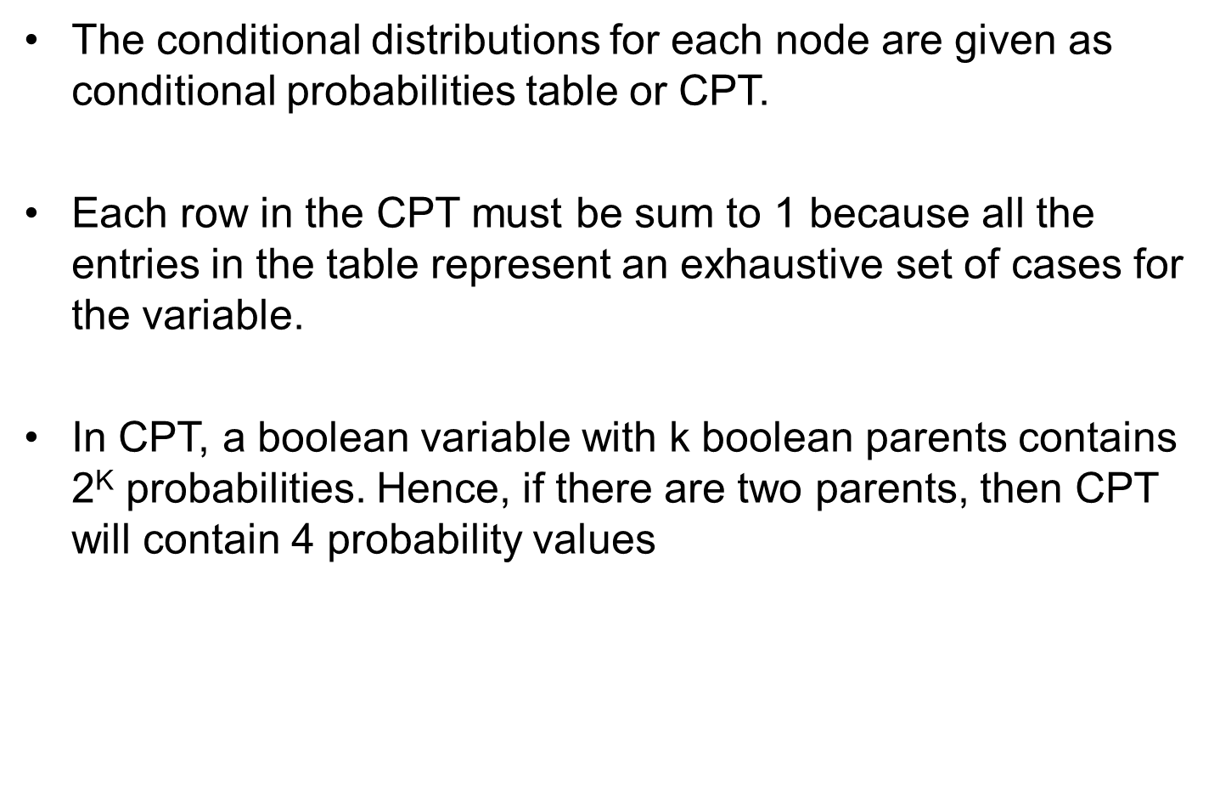
Bayesian Belief Network Example

Slide 18
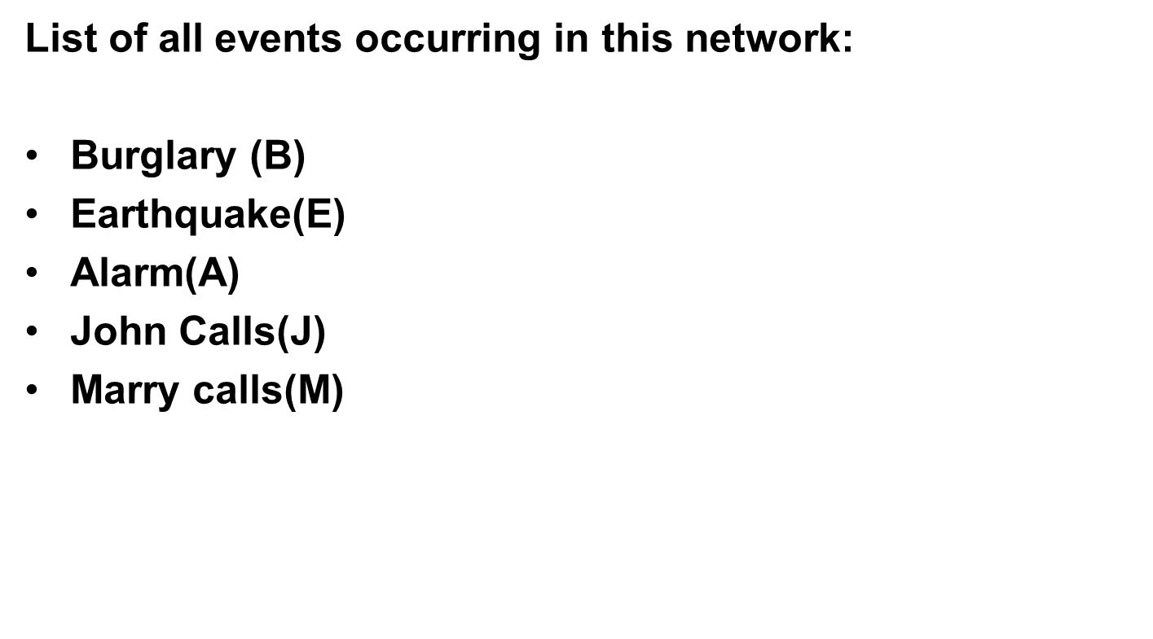
Bayesian Belief Network Example

Slide 19
Bayesian Belief Network Example
We can write the events of problem statement in the form of probability: P[D, S, A, B, E], can rewrite the above probability statement using joint probability distribution:
P[J, M, A, B, E]= P[J | M, A, B, E]. P[M, A, B, E]
=P[J | M, A, B, E]. P[M | A, B, E]. P[A, B, E]
= P [J| A]. P [ M| A, B, E]. P[ A, B, E]
= P[J | A]. P[ M | A]. P[A| B, E]. P[B, E]
= P[J | A ]. P[M | A]. P[A| B, E]. P[B |E]. P[E]

Slide 20
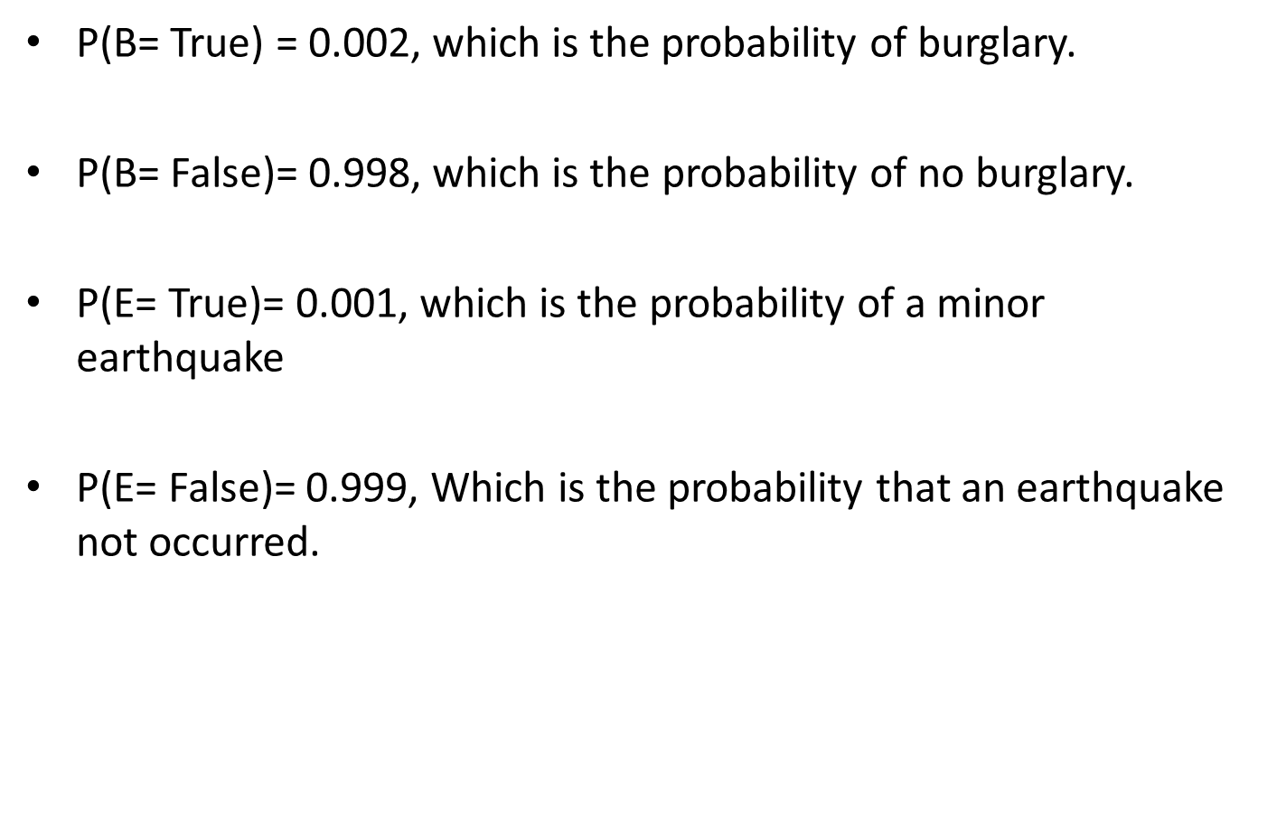
Bayesian Belief Network Example

Slide 21
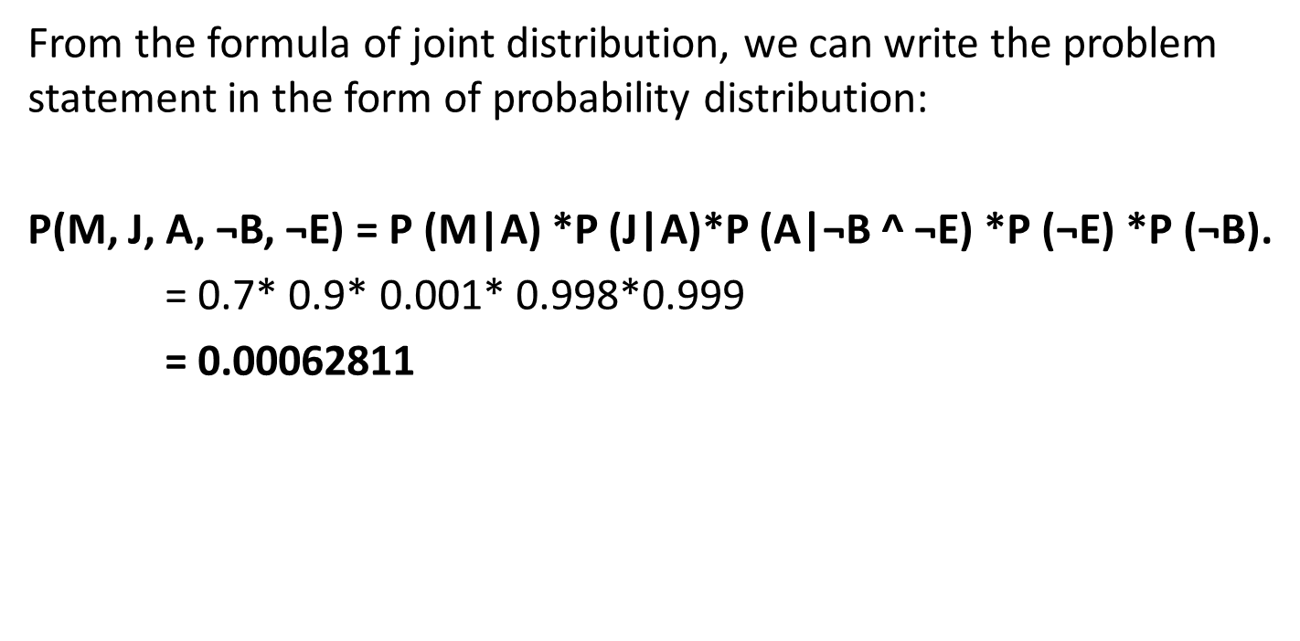
Bayesian Belief Network Example

Slide 22
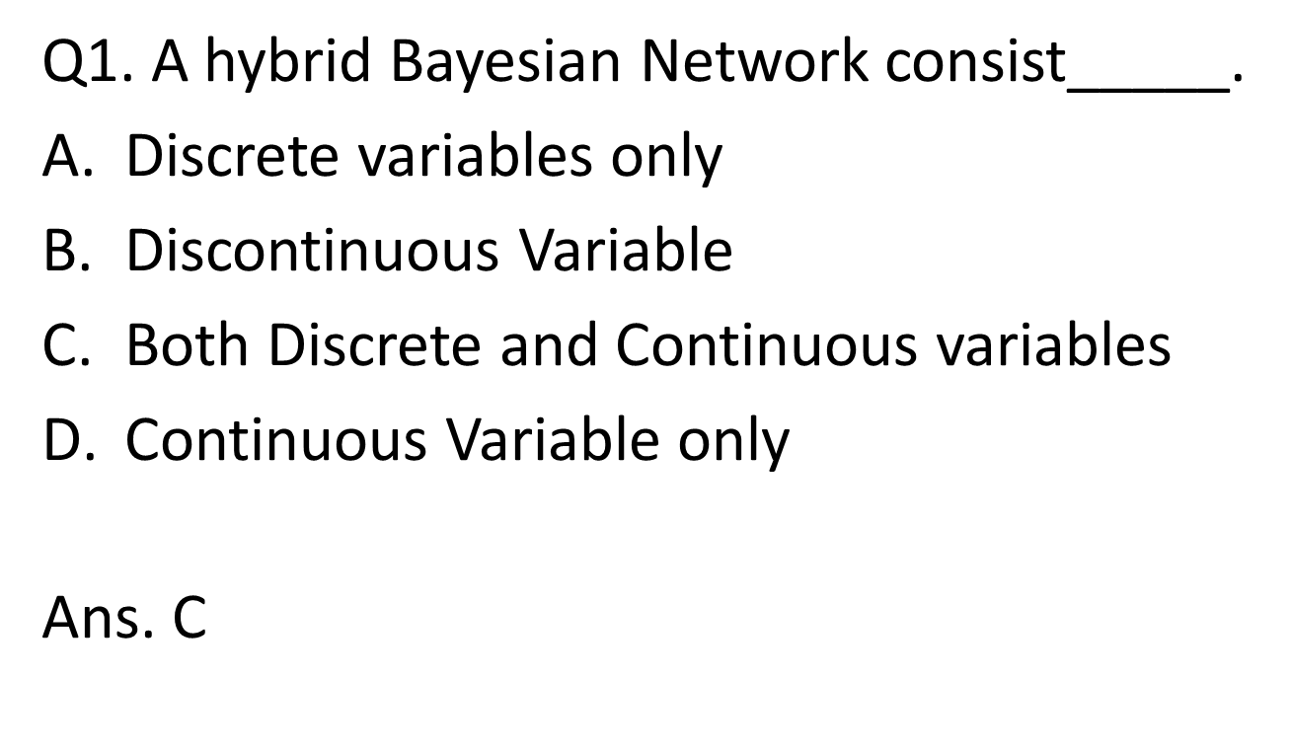
MCQ
Alka Singh ACSAI-301 AI Unit 04

Slide 23
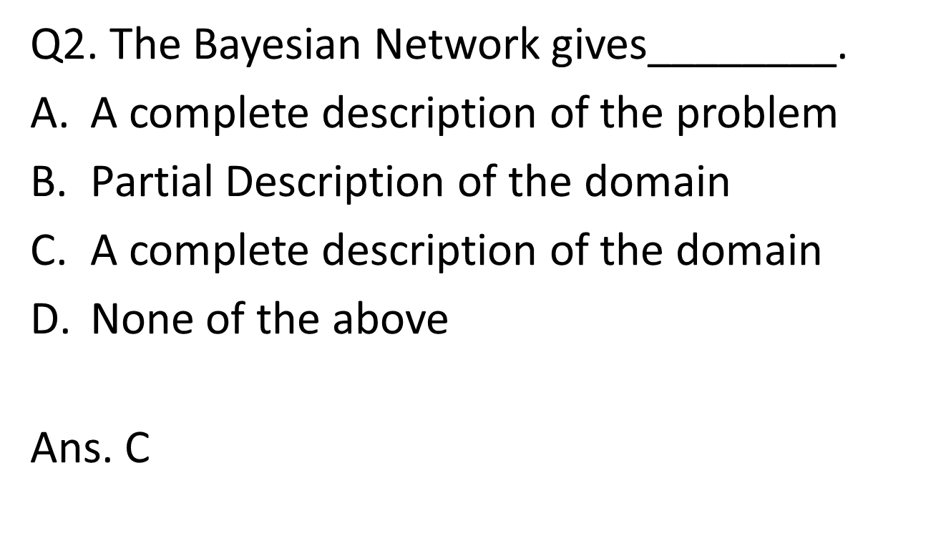
MCQ
Alka Singh ACSAI-301 AI Unit 04

Slide 24
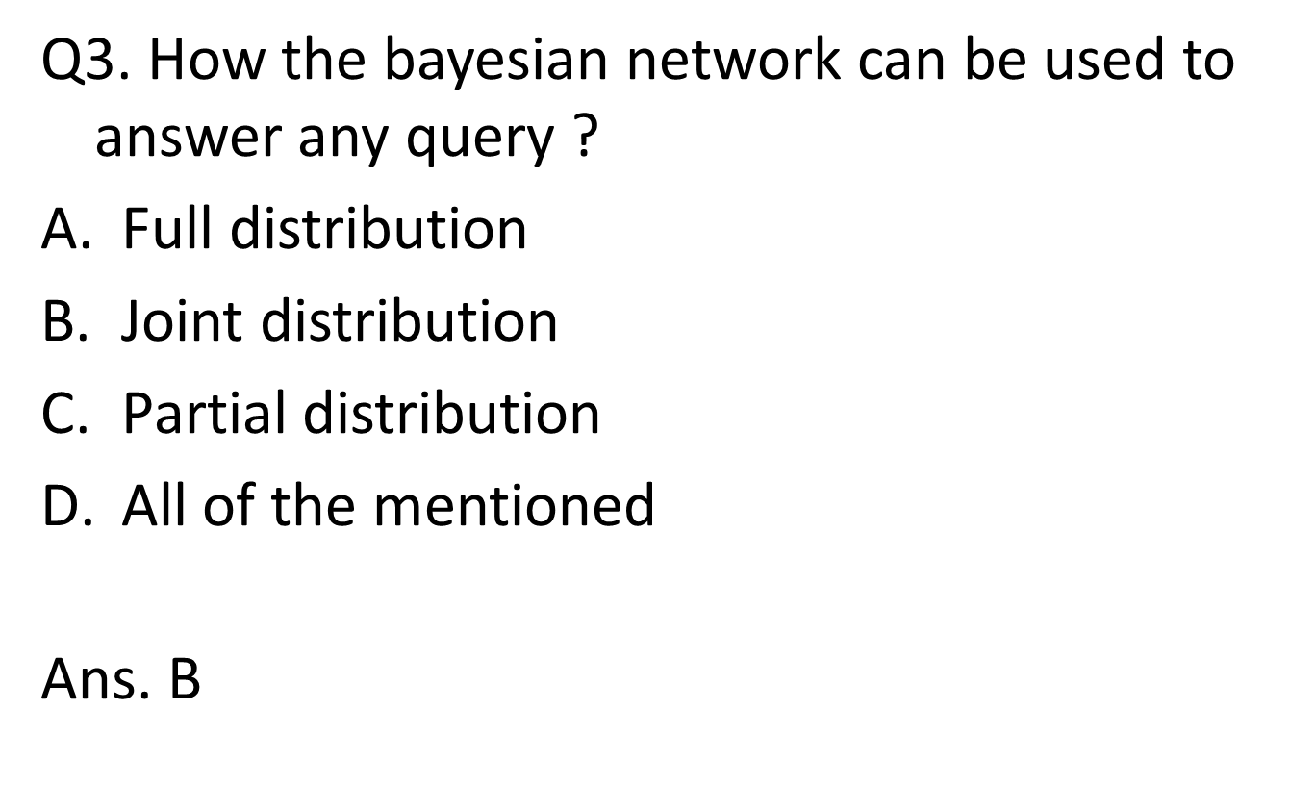
MCQ
Alka Singh ACSAI-301 AI Unit 04

Slide 25
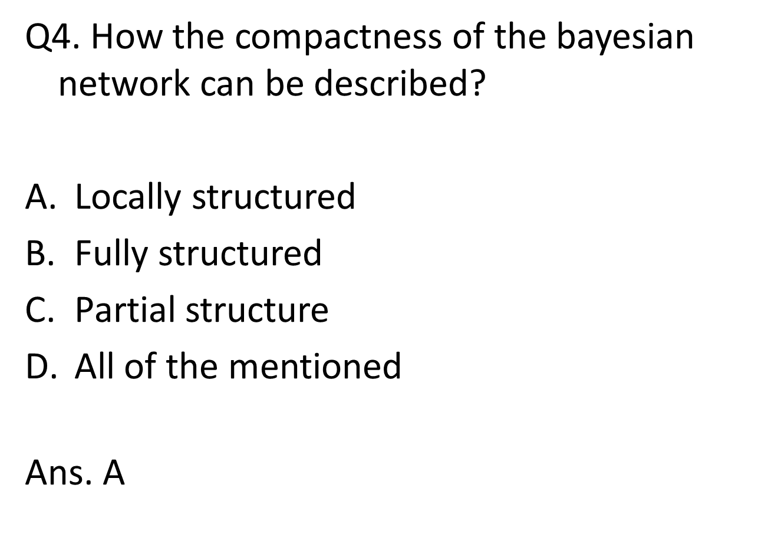
MCQ
Alka Singh ACSAI-301 AI Unit 04

Slide 26
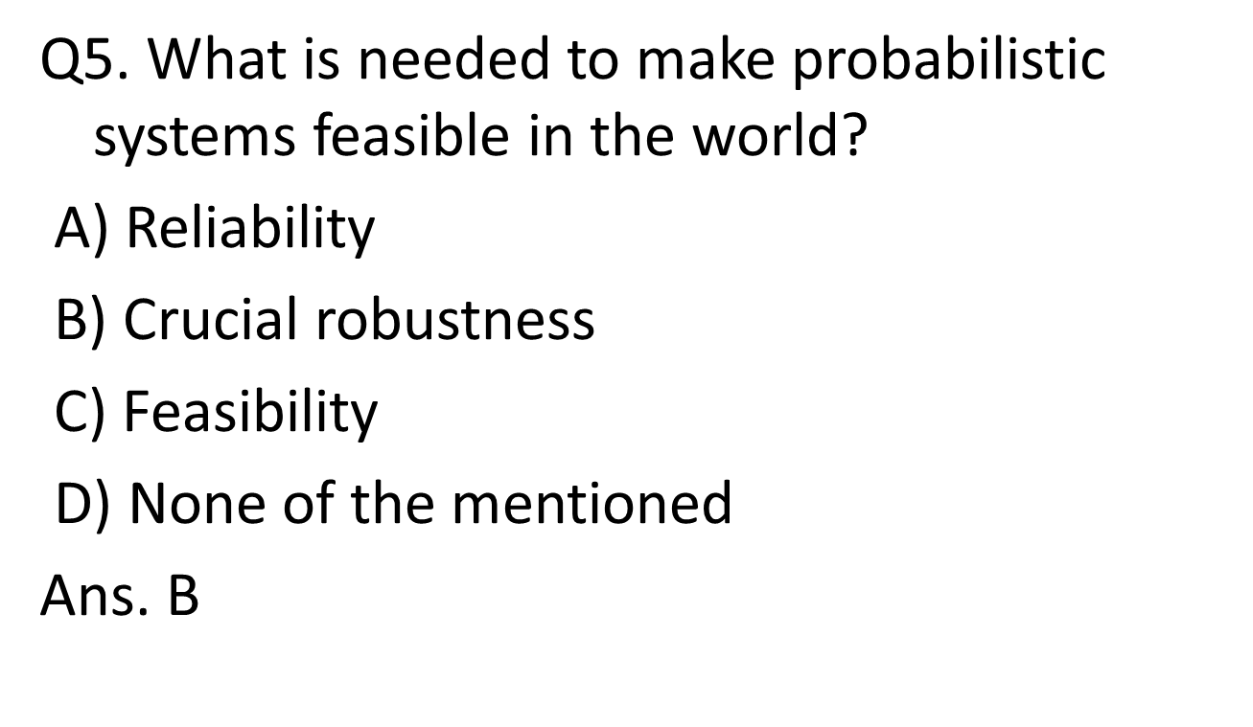
MCQ
Alka Singh ACSAI-301 AI Unit 04

Slide 27
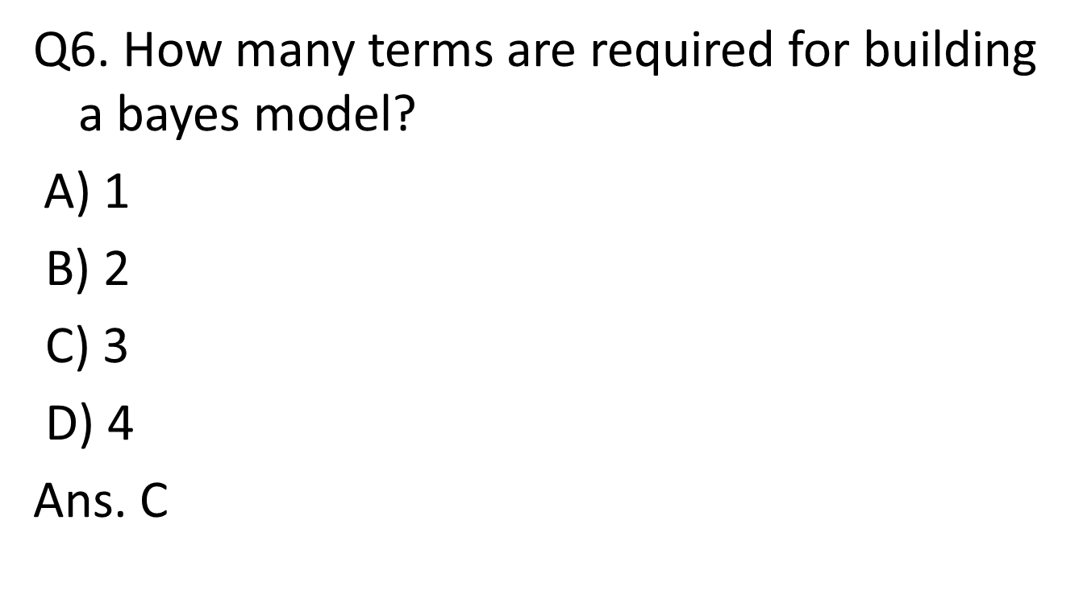
MCQ
Alka Singh ACSAI-301 AI Unit 04

Slide 28
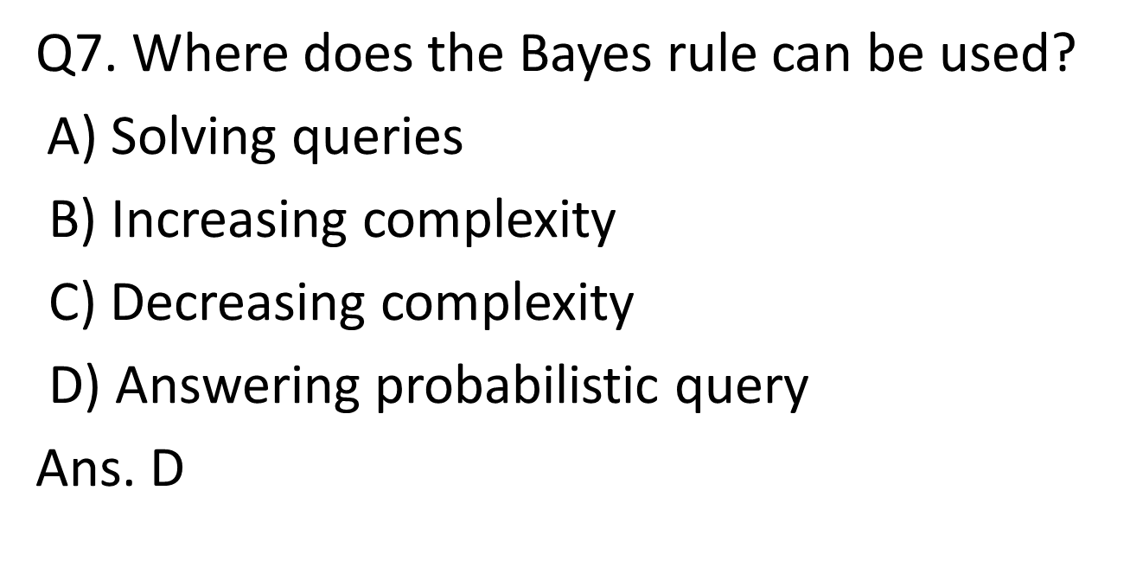
MCQ
Alka Singh ACSAI-301 AI Unit 04

Slide 29
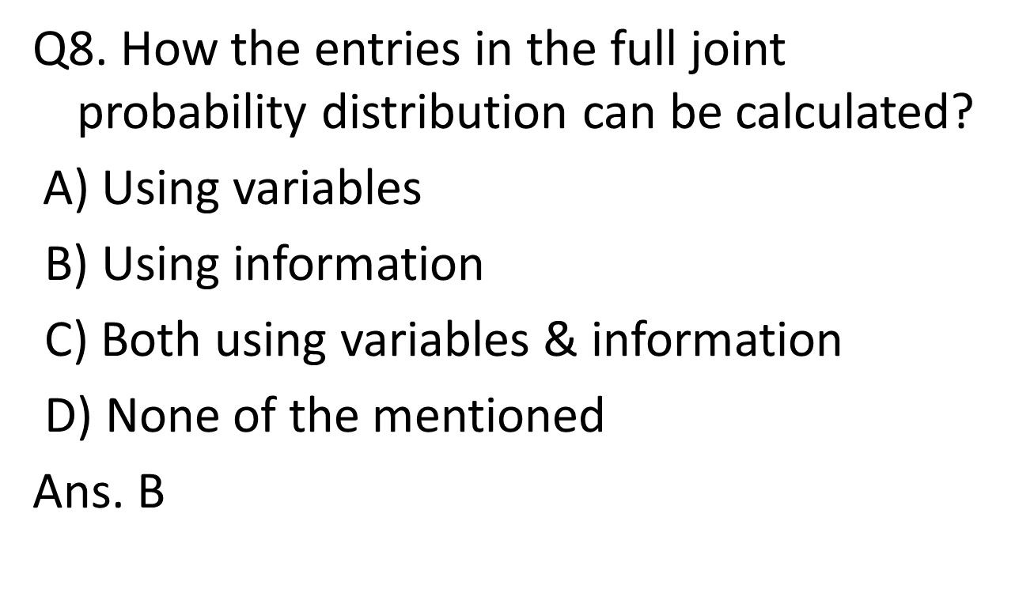
MCQ
Alka Singh ACSAI-301 AI Unit 04

Slide 30
Assignment
What are the applications of Knowledge Based System Design?
What are the various Knowledge Representation Schemes?
Explain Forward Chaining and Backward Chaining with diagram.
Elaborate architecture of Knowledge Based Systems.
Explain concept of Frames using Example.
Explain rule based system with respect to Expert System.
Explain Uncertainty management in Expert Systems.
What do you mean by Probabilistic Methods?
Define Knowledge Based Agent.
What are the parts of Knowledge Based Agent?
Draw and explain the architecture of Knowledge Based Agent.
Why there is need of probabilistic reasoning in AI?
Explain Forward Chaining and backward chaining in AI with example.
Alka Singh ACSAI-301 AI Unit 04

Slide 31
Assignment
What are the two approaches to build a knowledge-based agent. Explain.
"A knowledge-based agent can be viewed at different levels",describe.
Explain Expert System with the help of Block Diagram.
Describe Architecture of Expert System in detail.
Write advantages and disadvantages of Expert system
Write down applications of Expert system.
Define Probabilistic Reasoning.
Define various types of knowledge.
Explain drawbacks in Semantic representation.
Explain the operations performed by Knowledge Based Agent in order to show the intelligent behaviour:
A knowledge-based agent can be viewed at different levels. Explain.
What are the advantages of using Frames?
Alka Singh ACSAI-301 AI Unit 04

Slide 32
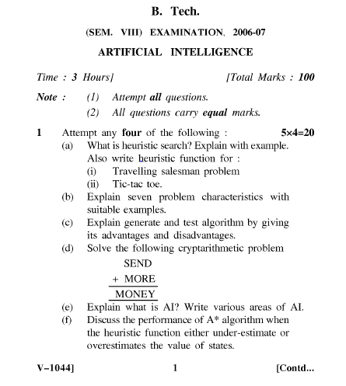
Old Question Papers
Alka Singh ACSAI-301 AI Unit 04

Slide 33
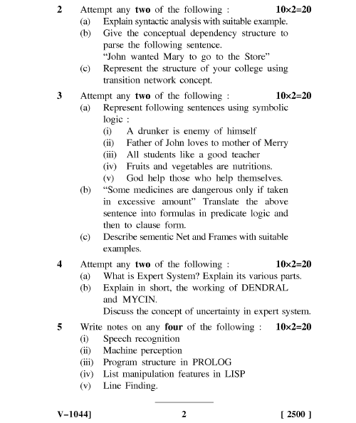
Old Question Papers
Alka Singh ACSAI-301 AI Unit 04

Slide 34

Alka Singh AI Unit 04
Alka Singh ACSAI-301 AI Unit 04

